Slide 1

Automated Bidding Food Stuff System
[ Capstone Design Project ]
2015115406 Gu MinSeok
2015115907 Kim Minseok
2015112746 Park Juhong
2015110986 Hong Seongbin

Slide 2











CONTENTS
1. Current
5. Diagram
2. Problem
6. Implementation
3. Project Goal
7. Video
4. Outline
8. Process and Q&A

Slide 3






Current
“Ok, I will upload ingredients request on website to find suppliers”
“I have to know what I can supply AND
have to see websites periodically AND
have to read their request AND
have to match their needs and what I have”
“But there is no regular registration form so I write it whatever I want”
School Administration
Suppliers
“I want ingredients to make school meal”
Bidding Website
eat.school.go.kr
School Nutritionist
What Suppliers can support
Notes:
우리는 많은 시간을 반복적인 일을 하며 보내고 있다.

Slide 4


Problem
Suppliers have to do many and same works REPEATEDLY
Notes:
상공회의소에서 조사한 평균 직장인의 노동시간
36% 반복되는 업무

Slide 5
Problem : Suppliers’ TO-DO List
1. have to see websites periodically
-> Solution : Someone gets access to the website
and check new requests periodically
Notes:
상공회의소에서 조사한 평균 직장인의 노동시간
36% 반복되는 업무

Slide 6


Problem : Suppliers’ TO-DO List
2. have to read their request
-> Solution : Someone interprets their weird requests and extracts appropriate contents
Notes:
상공회의소에서 조사한 평균 직장인의 노동시간
36% 반복되는 업무

Slide 7

Problem : Suppliers’ TO-DO List
3. have to know what I can supply
-> Solution : Someone remembers what Suppliers have
Notes:
상공회의소에서 조사한 평균 직장인의 노동시간
36% 반복되는 업무

Slide 8
Problem : Suppliers’ TO-DO List
4. have to match their needs and what I have
-> Solution : Someone match their needs and the products suppliers have
Notes:
상공회의소에서 조사한 평균 직장인의 노동시간
36% 반복되는 업무

Slide 9
Problem : Suppliers’ TO-DO List
Conclusion : I need SOMEONE to do repeated works as I order
But I don’t have that much MONEY to hire person..
Notes:
상공회의소에서 조사한 평균 직장인의 노동시간
36% 반복되는 업무

Slide 10

Project Goal
Q. Hiring person is too expensive. But there are still too many repetitive work, then what am I gonna do?
A. How about Robot?
Someone
Robot

Slide 11



Project Goal : Salary
Result of Korea Economy Research Center
All office workers in Korea
Average Yearly Salary
: 3,420만원 ($29,000)
Major Company
Average Yearly Salary
: 6,460만원 ($55,000)
Notes:
한국경제연구원 기준 평균 임근 3420 대기업기준 6460

Slide 12

Project Goal : Profit
Save 3420만원 ($29,000) averagely
Notes:
한국경제연구원 기준 평균 임근 3420 대기업기준 6460

Slide 13

Outline
School
Robot
Supplier
Notes:
이게 우리 팀프로젝트다

Slide 14


System Diagram
Robot
Machine Running
School
Supplier
food materials in Database

Slide 15


Detail Diagram
Normalized Result
Cloud Server
RPA
Read Excel
: Free Form
Machine
Learning
Excel : Free Form
Excel : Free Form
A School Administration
RPA
Text
Normalization Model
RPA
Match the Normalized Result
and Grocery DB Records
B School Administration
Bidding Website
eat.school.go.kr
Check the result and
Choice whether bid or not
C School Administration
Grocery DB
Supplier

Slide 16

Implementation
Key development functions
Machine Running
RPA
Server

Slide 17
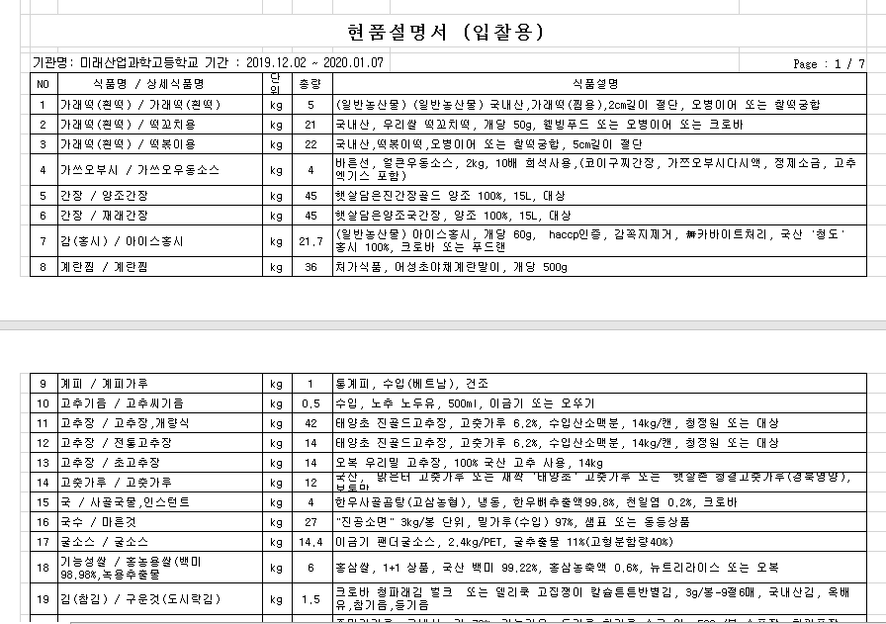
School Request Sample
We will use Category and Description of Products
Estimate the products’ names

Slide 18

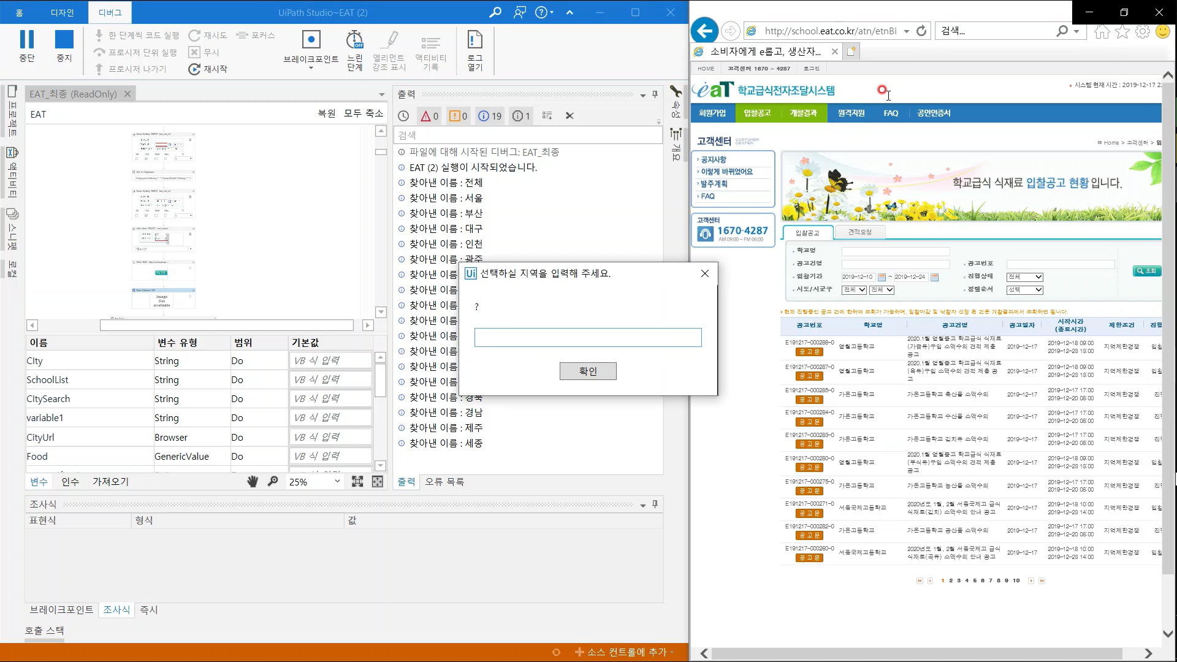
Implementation : RPA
Step 1.
Write the location name to find schools’ requests
(ex. 서울, 대구 등)

Slide 19
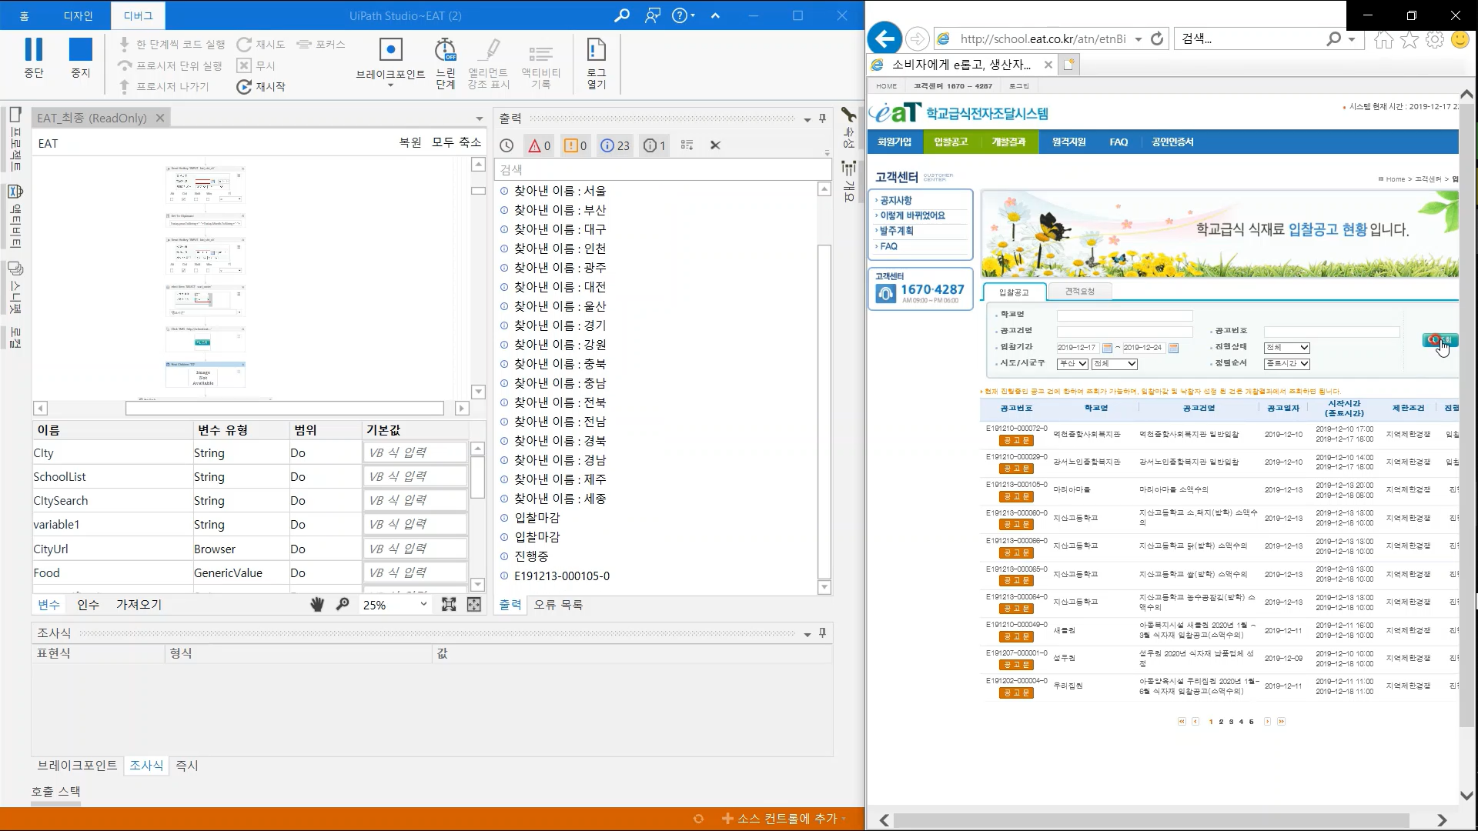
Implementation : RPA
Step 2.
Check the deadline and find schools having requests in deadline

Slide 20
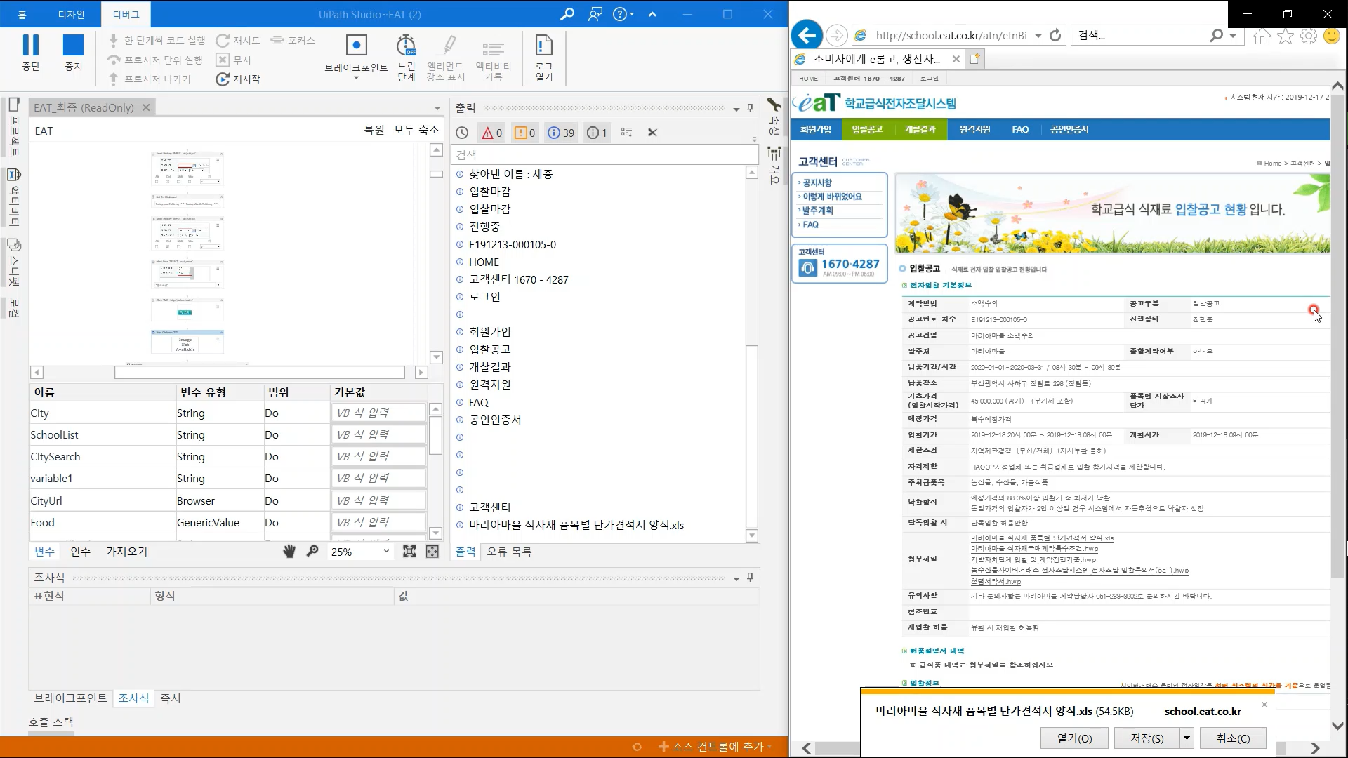
Implementation : RPA
Step 3.
Get excel file containing ingredients info.

Slide 21
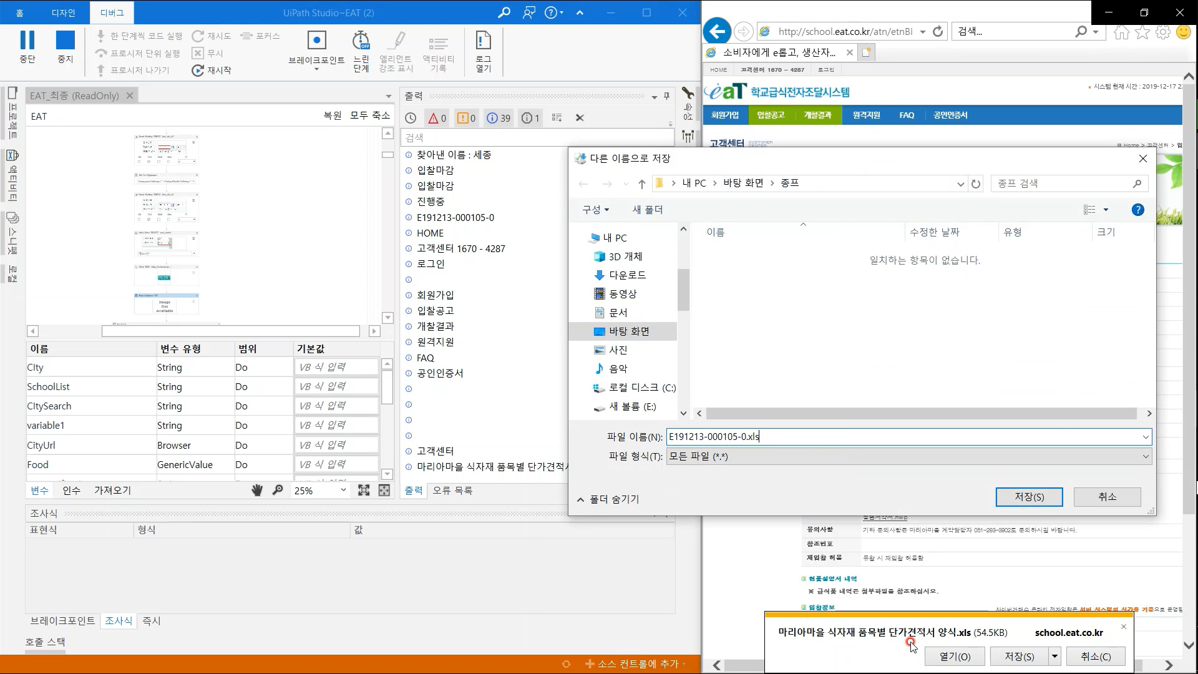
Implementation : RPA
Step 3-1.
Get excel file containing ingredients info.

Slide 22
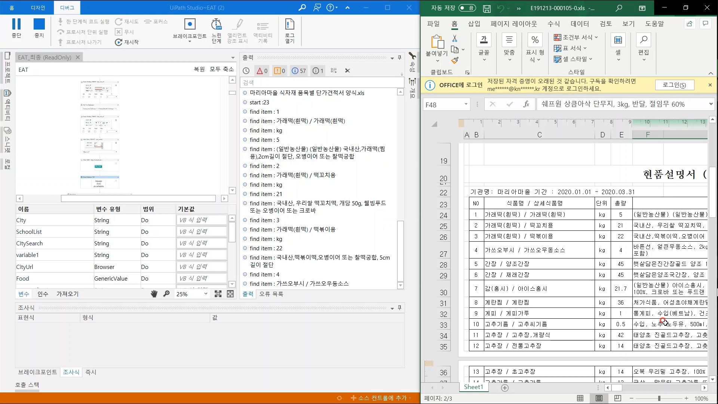
Implementation : RPA
Step 4.
Open and Read the contents in excel file

Slide 23
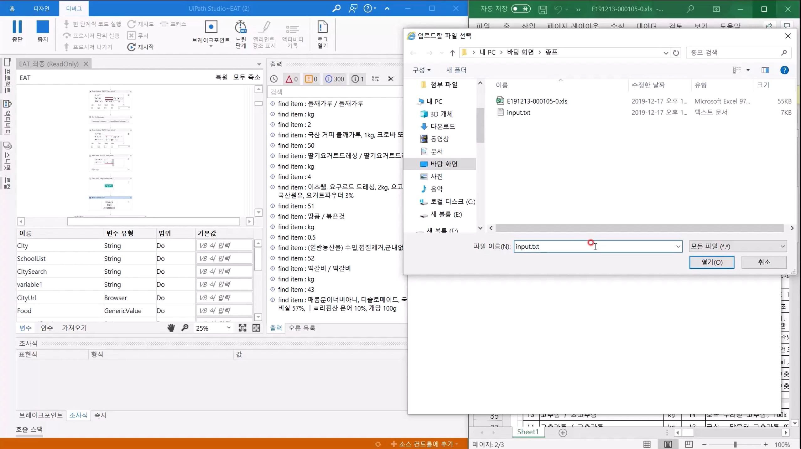
Implementation : RPA
Step 5.
Transform the Excel contents to Text File

Slide 24
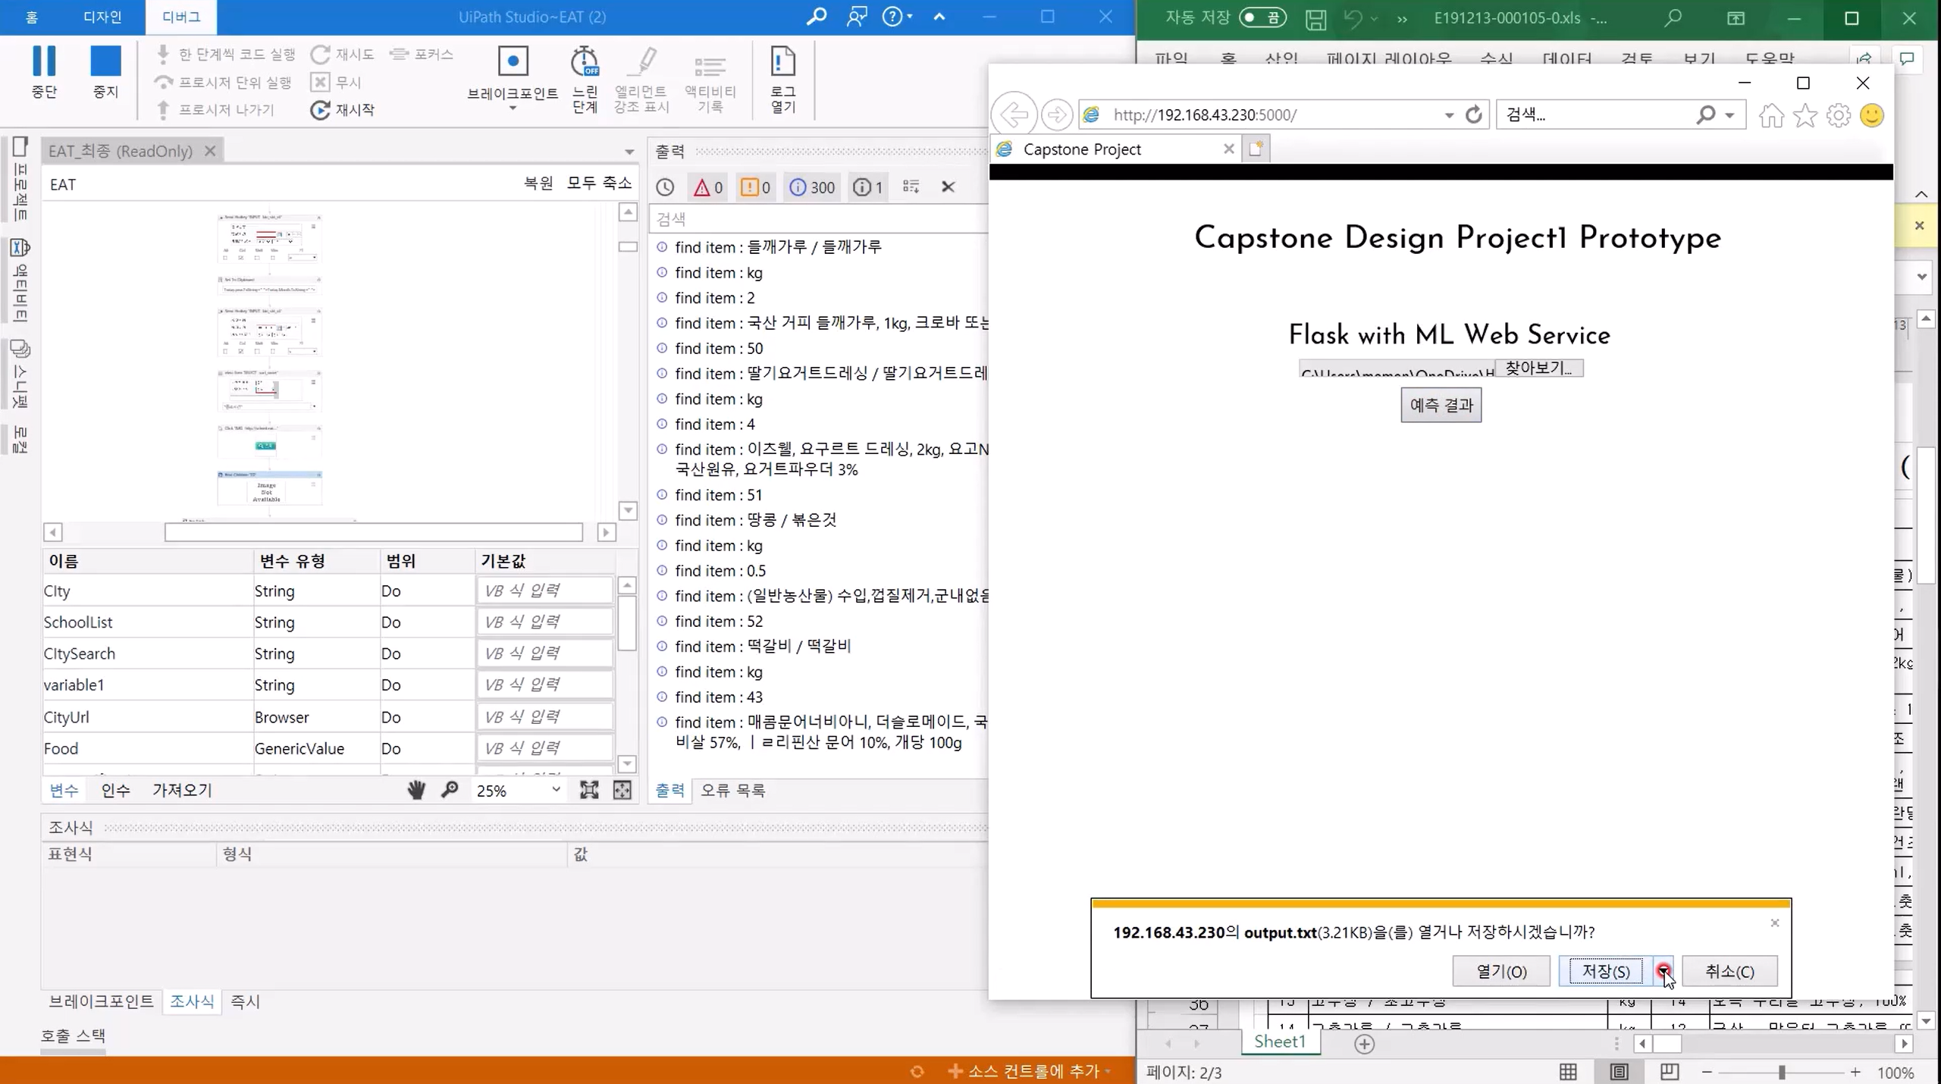
Implementation : Server & Machine Learning
Step 6.
Transfer Text File to Server

Slide 25
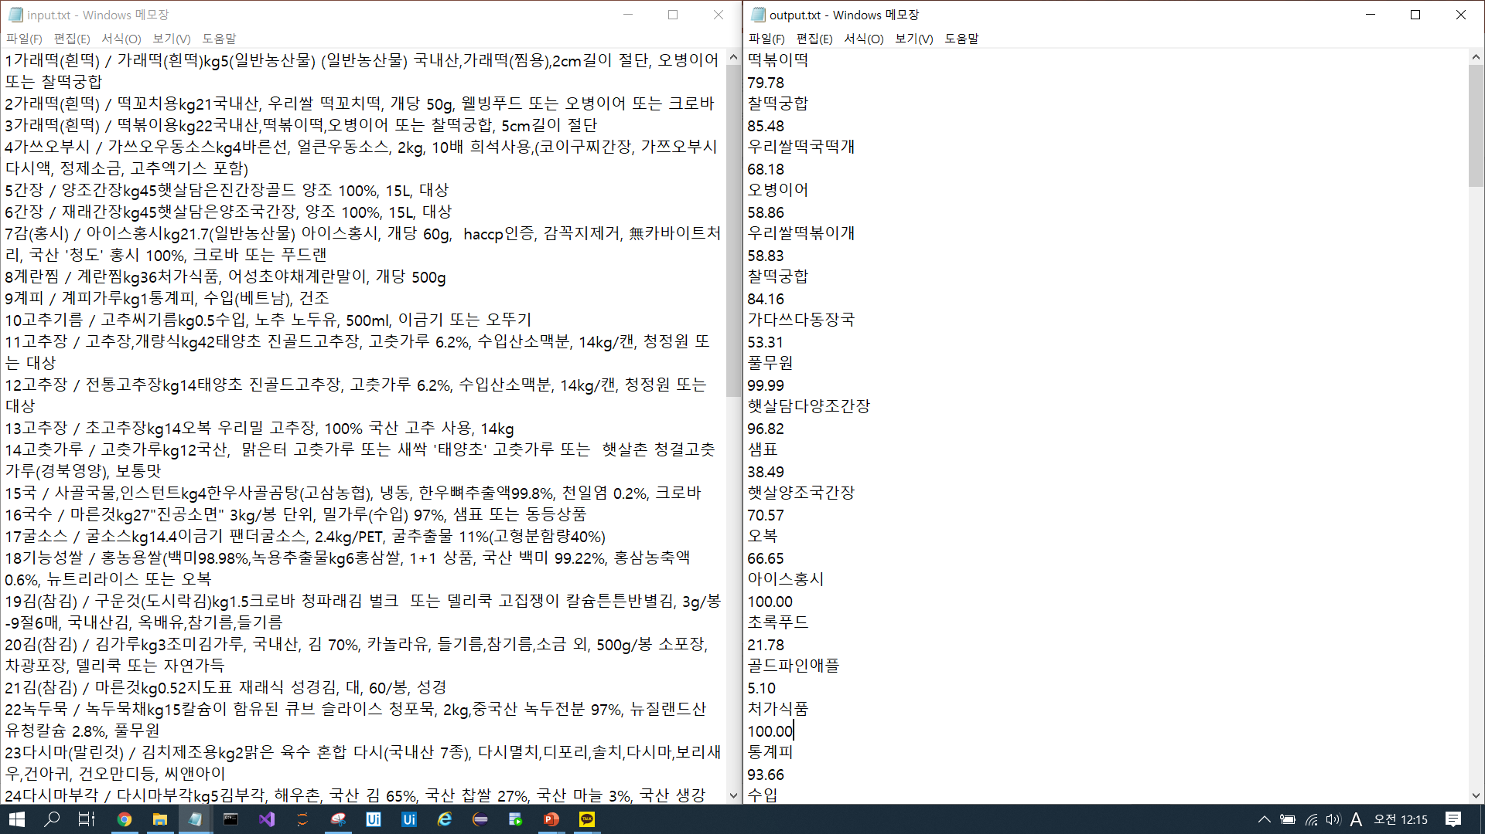
Implementation : Server & Machine Learning
- Estimated Product Name
- Product Name Accuracy
- Estimated Product Manufacturer
- Product Manufacturer Accuracy
Step 7.
Make Unnormalized Contents to Normalized Contents

Slide 26
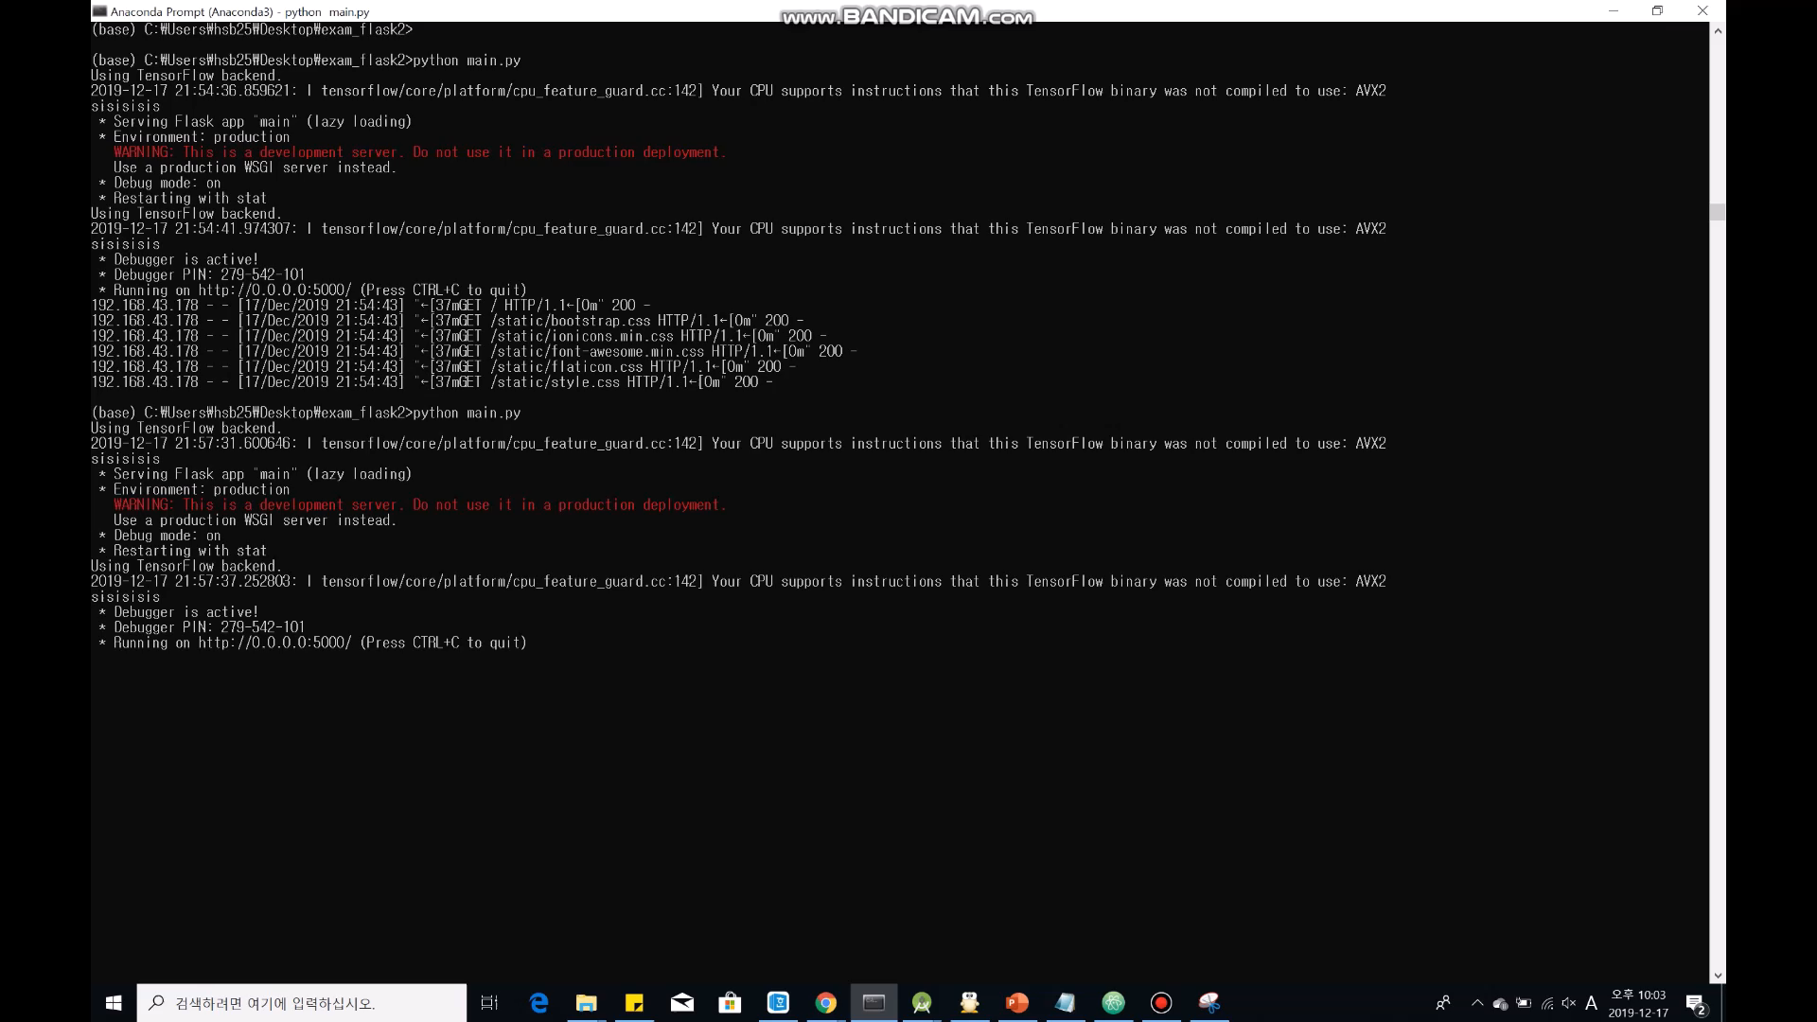
Implementation : Server & Machine Learning
Step 7-1.
Model evaluates the input data in Flask Server

Slide 27
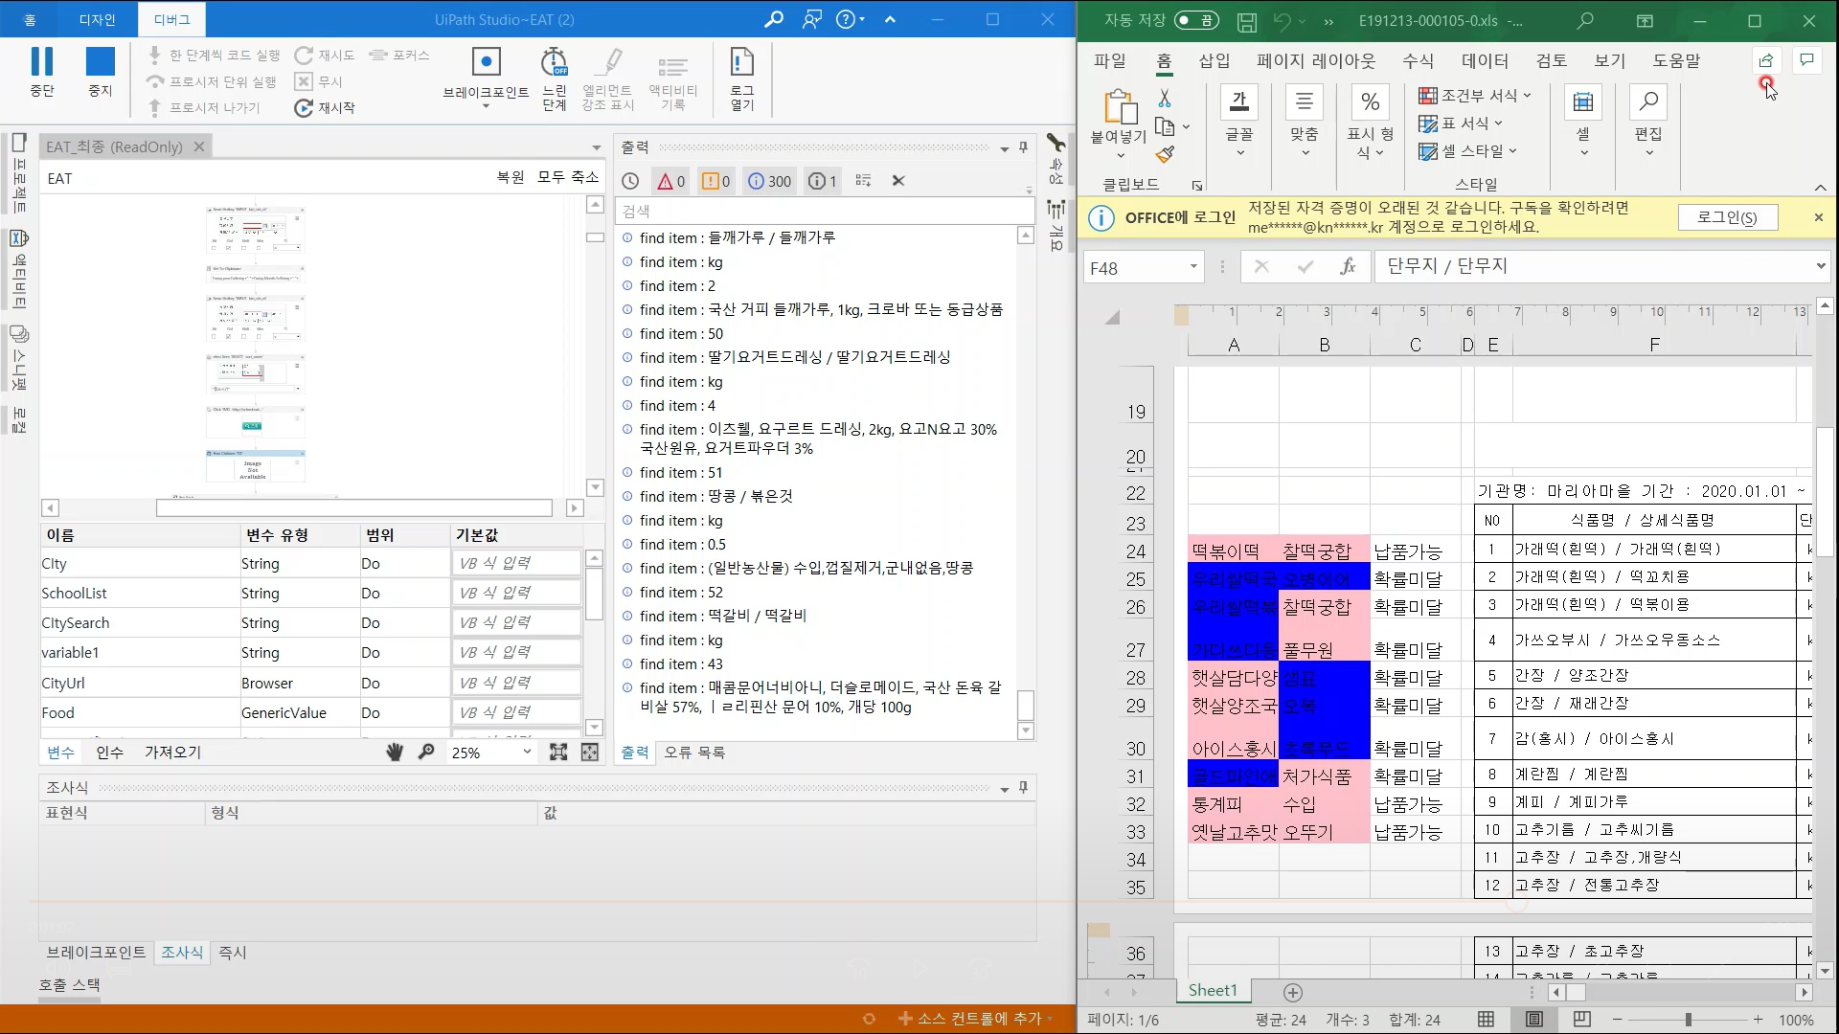
Implementation : RPA
Step 8.
Show results on excel file
estimation accuracy by colors.

Slide 28
Implementation : RPA
Step 8-1.
Also Show the results whether supplying possible or not

Slide 29
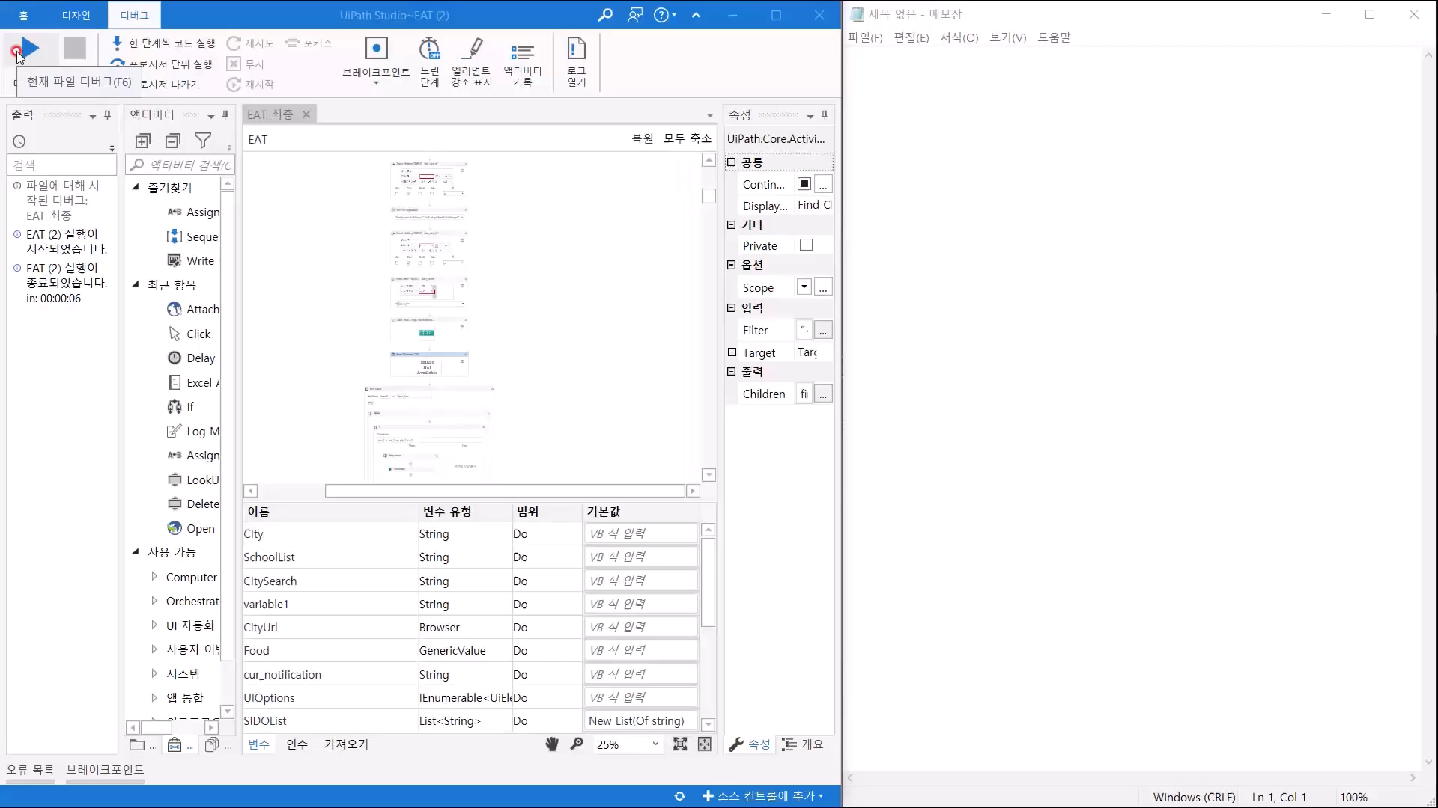
Video

Slide 30

Process
 | Sep. Week1 | Sep. Week2 | Sep. Week3 | Sep. Week4 | Oct. Week1 | Oct. Week2 | Oct. Week3 | Oct. Week4 | Nov. Week1 | Nov. Week2 | Nov. Week3 | Nov. Week4
Set a asubject
Study ML
Study RPA
Programming ML
Programming RPA
Make a Server
Combine result
Modify and Test

Slide 31

Q&A

Slide 32
THANK YOU

